Slide 1


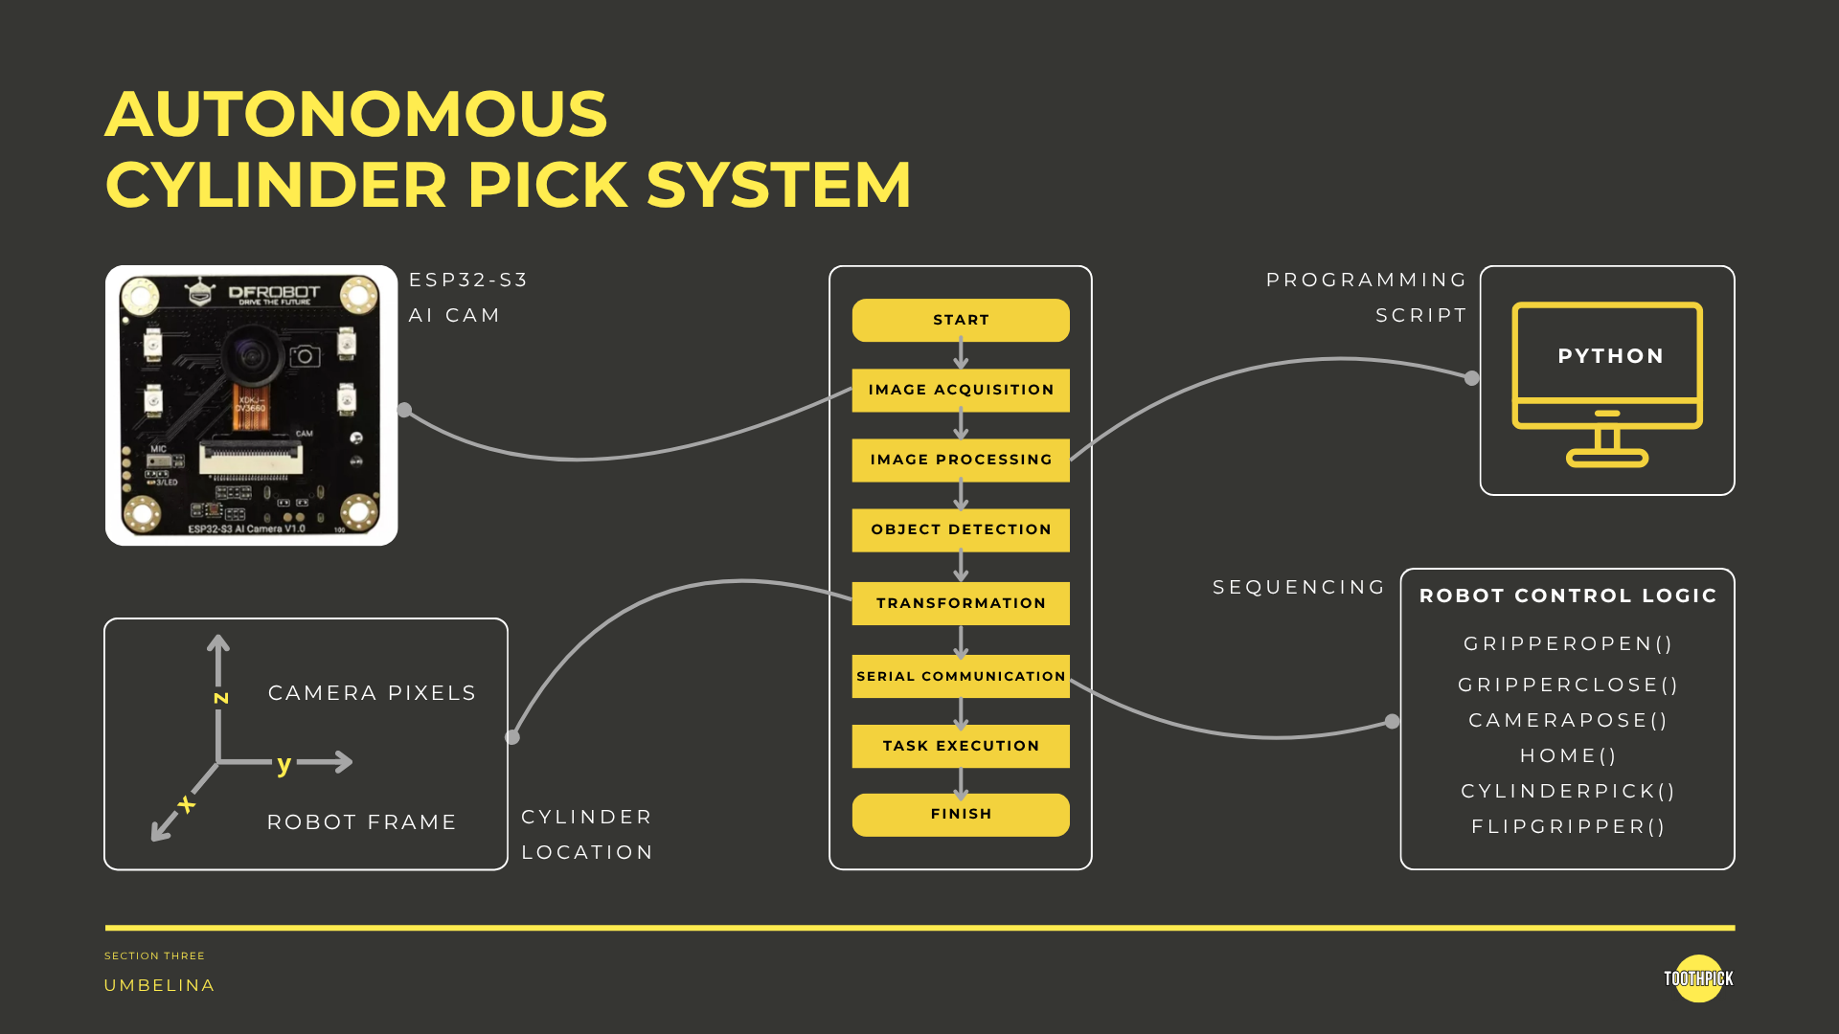

SECTION TITLE

Slide 2

AUTONOMOUS CYLINDER PICK SYSTEM
CHAPTERS
PRODUCT OVERVIEW
HARDWARE AND BASE SOFTWARE
CAMERA SEQUENCING
END-EFFECTOR SEQUENCING

Slide 3
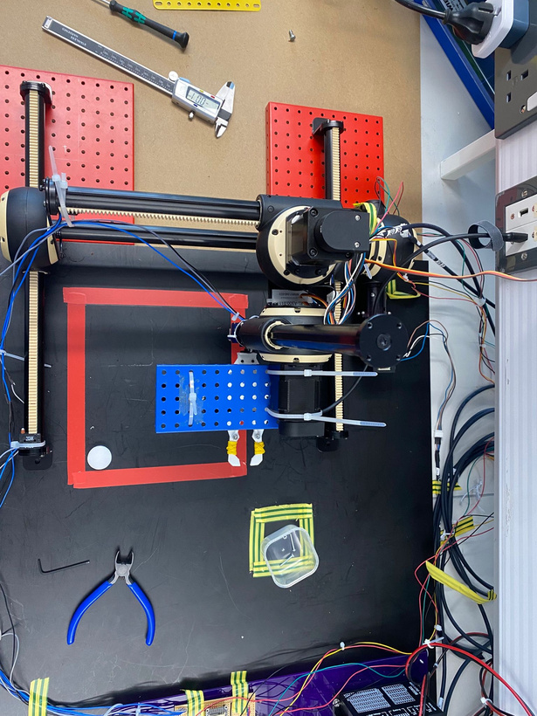
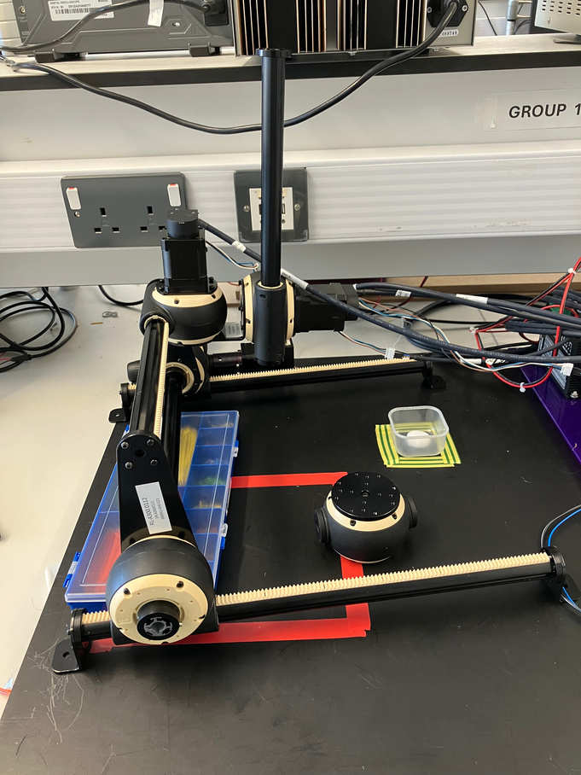
AUTONOMOUS CYLINDER PICK SYSTEM
OUR PRODUCT
  3DOF Gantry Robot
  Gearbox with teethed rails
  3 Stepper Motors, 2 Servo Motors
  Homing system
WHY?
  Accurate, repeatable and simple​
  Stable structure​
  Ideal for environment
Daniel
caff.co
app.co

Slide 4
Hardware and Base Software
ESP32-S3-DEV2
Compact
Processing Capability
WiFi/
Bluetooth
Stripboard
Permanent
Less Wiring
Minimise
Disconnect
Limit Switches
Boundaries
Homing
SECTION TWO
Nikitha

Slide 5
Hardware and Base Software
2 Micro Servos
End-Effector
Grip and Flip
Modular Code
Adaptable
Intuitive
Functions
Scalable
Homing Routine
Consistent Positioning
Reference
SECTION TWO
Nikitha

Slide 6
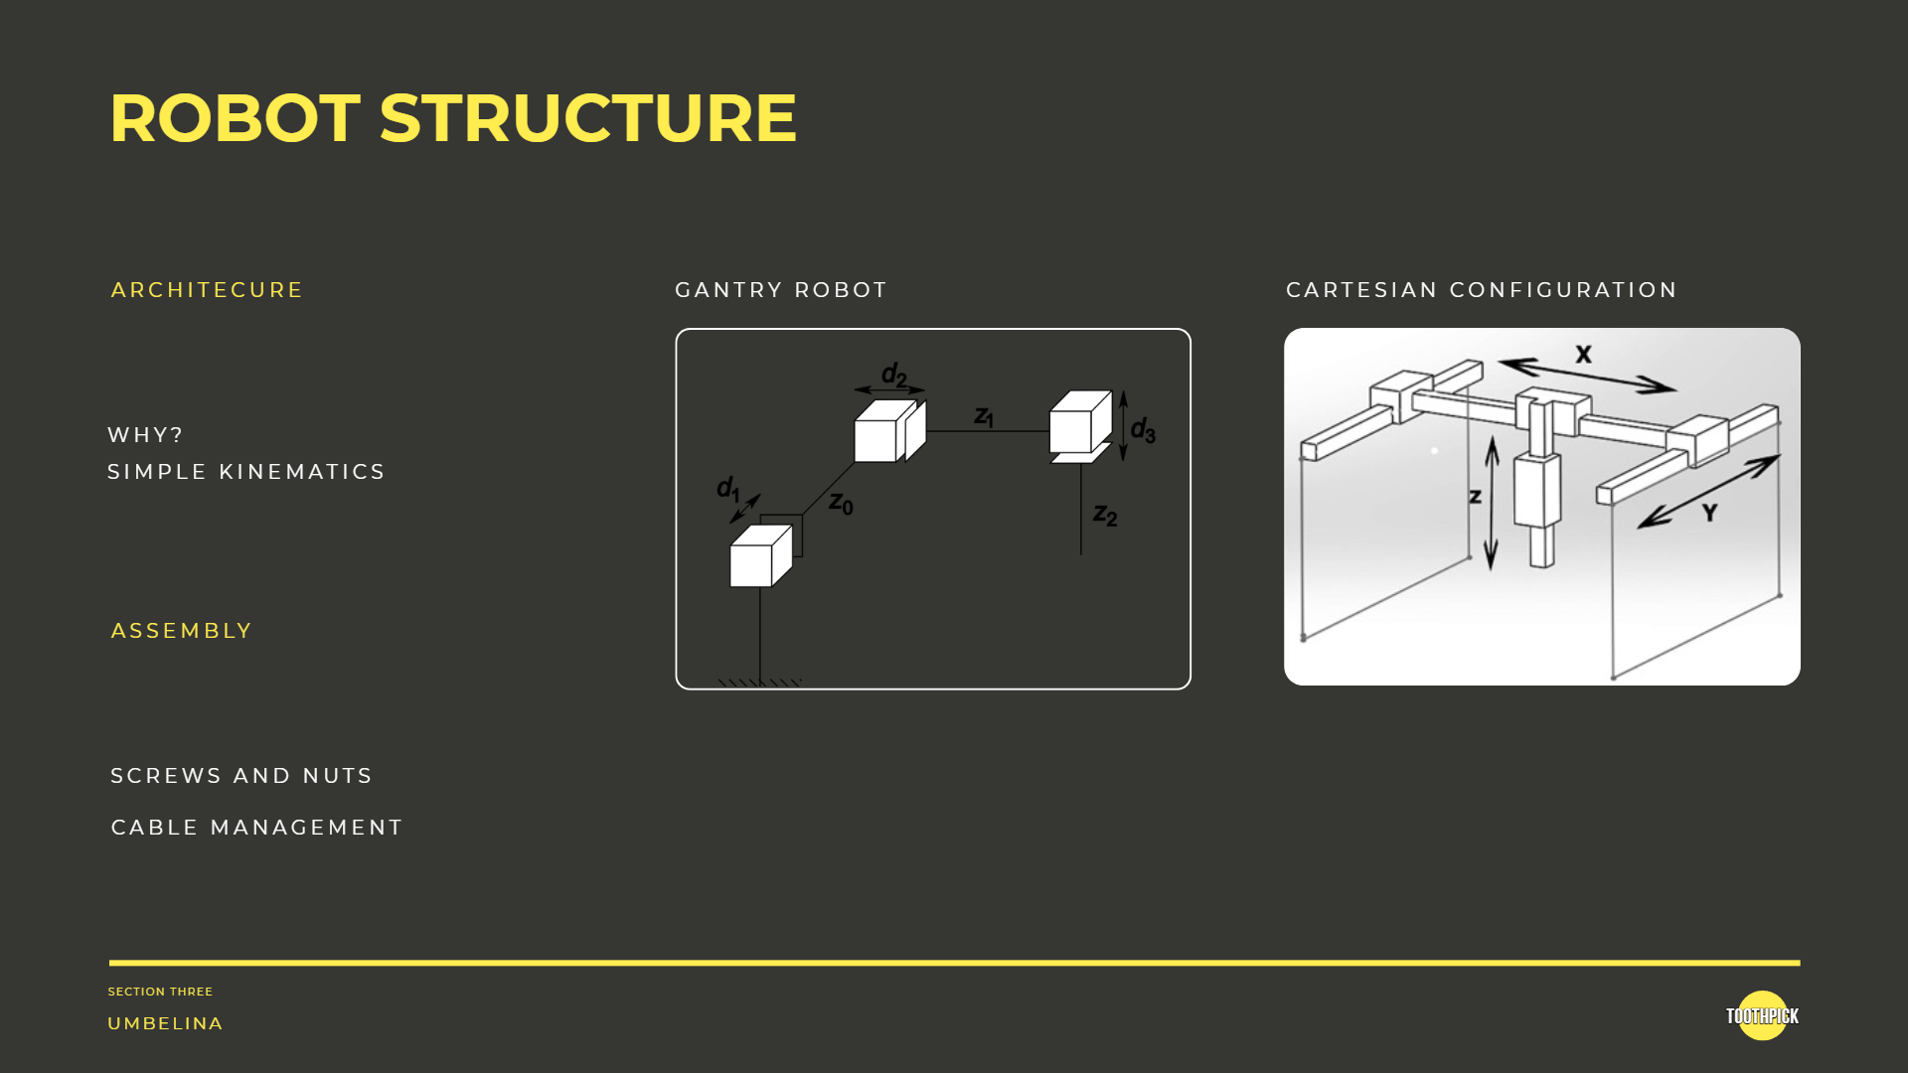

Slide 7
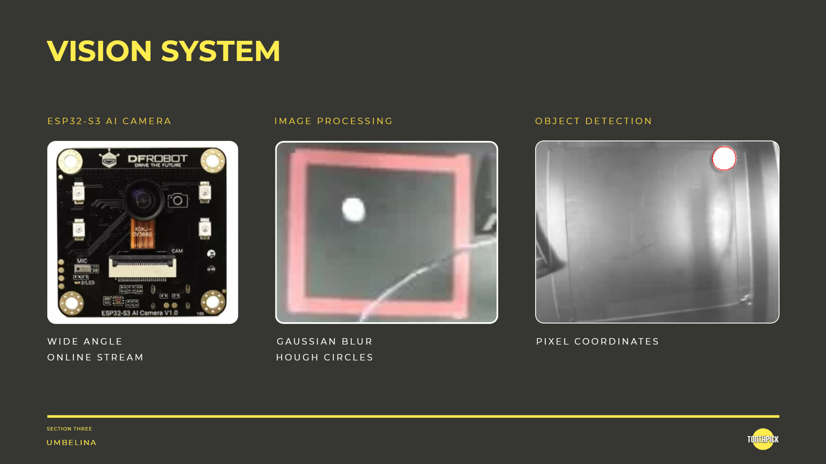

Slide 8
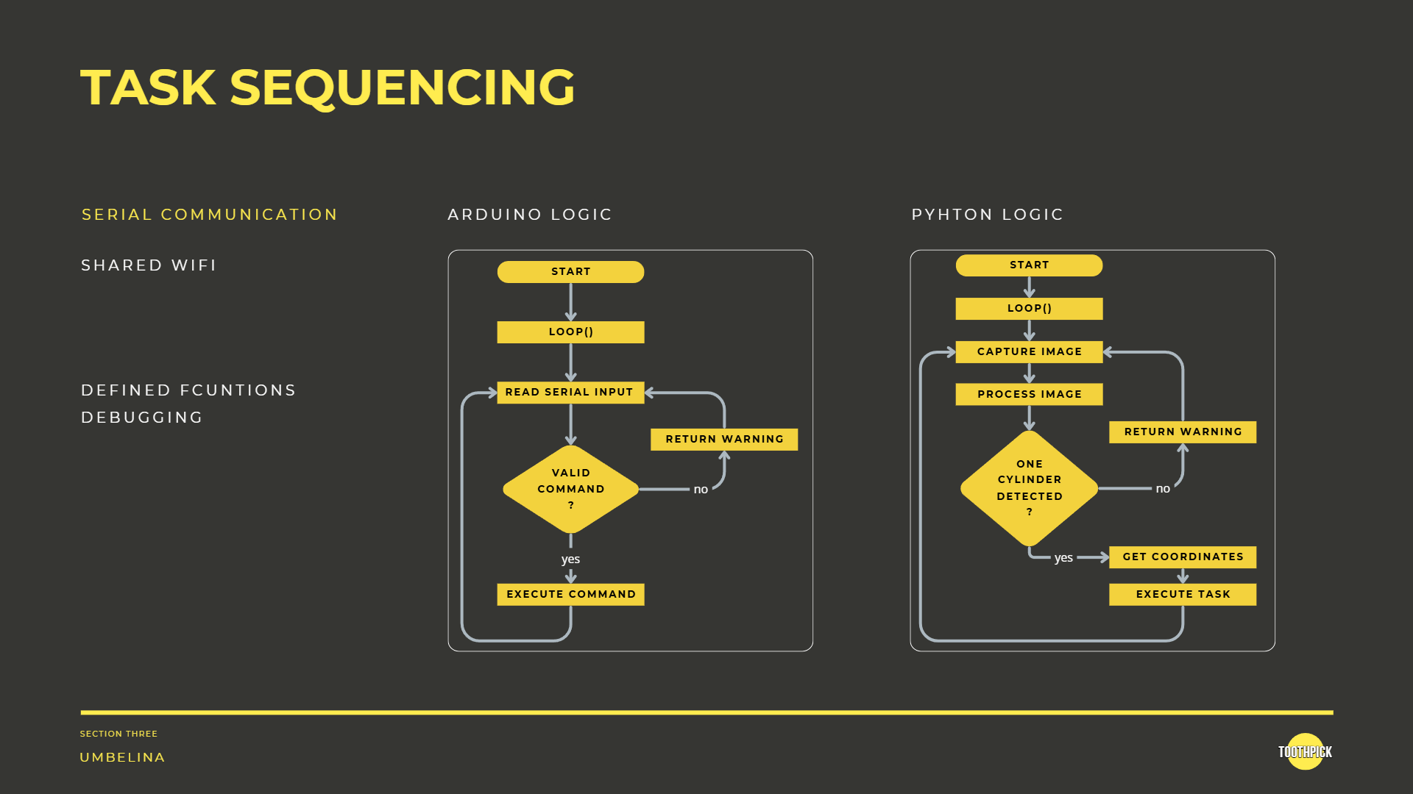

Slide 10
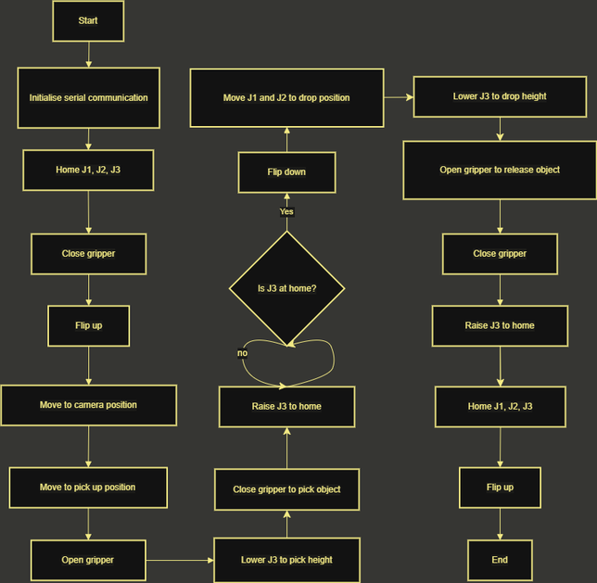
SEQUENCE
OVERVIEW
  Flipping of end effector limited to when J3 is home
  Drop limited to when J1 is at home
  Serial ‘DONE’ ensures each movement completes before the next begins
  Homing routine provides a repeatable reference position for every cycle
SECTION FOUR
Max

Slide 11
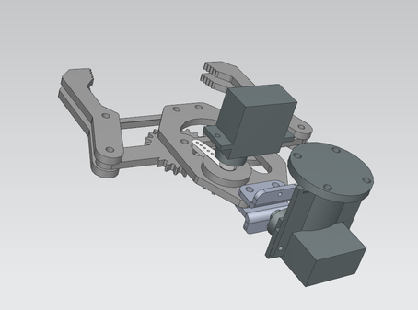
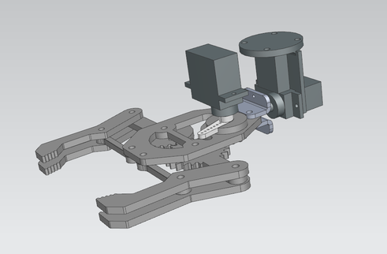
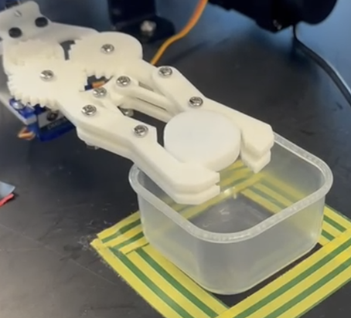
End Effector
SECTION FOUR
Max

Slide 12
SEE IT. PICK IT. SORT IT.
SECTION FINAL

